Slide 1



Inside Canadian Politics:
Public Opinion, Power and Canada’s Place in the World
Nik Nanos, CM, ICD.D
Chief Data Scientist

Slide 2
1
Canada and America
2
Political & Economic Mood
3
Canada and the World

Slide 3
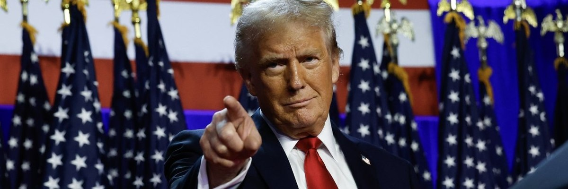
3
The Disruptor-in Chief.

Slide 4
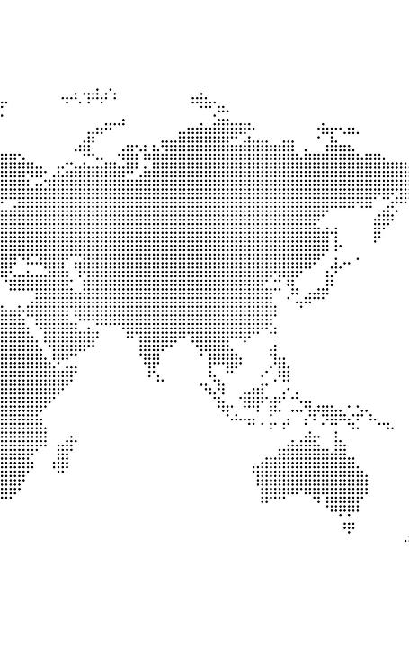
Threat to the security of Canada
© NANOS RESEARCH
Q – Which of the following countries, if any, do you think poses the greatest threat to the security of Canada right now? [RANDOMIZE] [SELECT ONE]
Just over 50% of Canadians believe that the United States poses the greatest threat to the security of Canada right now. Women are more likely than men to believe that the United States poses the greatest threat to Canadian security with 64% of women reporting that the United States poses the greatest threat while 45% of men report that the United States poses the greatest threat to Canadian security presently.
Source: Nanos Research, RDD dual frame hybrid telephone and online random survey, January 31st to February 4th, 2026, n=1009, accurate 3.1 percentage points plus or minus, 19 times out of 20.

Slide 5
1H – Canadians and Americans on business values — Since 2005
5
Question - Thinking about Canada in relation with the countries below, could you please identify the first and second ranked countries that are closest with Canada in terms of business values? [ROTATE] [FIRST RANKED]
Question - Thinking about the U.S. in relation with the countries below, could you please identify the first and second ranked countries that are closest with the United States in terms of business values? [ROTATE] [FIRST RANKED]
Notes:
Line chart for each year

Slide 6
Tariffs impact on purchase of US-made goods – Tracking
© NANOS RESEARCH
More than eight in ten Canadians report they are less likely to purchase US-made goods than before tariffs were put in place on Canadian exports to the US to one extent or another. This represents a noticeable increase over the past year.
Q - Compared to a year ago before the US put tariffs on Canadian exports into the US, are you more likely, somewhat more likely, somewhat less likely or less likely to purchase US-made goods, or does this have no impact on your likelihood to purchase US-made goods?
Question asked in May 2025 – Compared to before tariffs were put in place on Canadian exports into the US, are you more likely, somewhat more likely, somewhat less likely or less likely to purchase US-made goods, or does this have no impact on your likelihood to purchase US-made goods?
Question asked in December 2024 – If a tariff is put in place on Canadian exports into the US, would that make you more likely, somewhat more likely, somewhat less likely or less likely to purchase US-made goods, or would that have no impact on your likelihood to purchase US-made goods?
*Weighted to the true population proportion.
*Charts may not add up to 100 due to rounding.
Source: Nanos Research, RDD dual frame hybrid telephone and online random survey, November 29th to December 2nd, 2025, n=1009, accurate 3.1 percentage points plus or minus, 19 times out of 20.

Slide 7
Preferences for Canadian defense spending – Tracking
© NANOS RESEARCH
Most Canadians prefer Canada increase its military spending to reach the current two per cent NATO target. However, there is an increase since the previous wave of research in the proportion of Canadians who would like to see military spending reach five per cent of Canada’s gross domestic product.
Q – President Donald Trump has now called on all NATO countries to increase their military spending to 5% of GDP, up from the current target of 2%. Canada hasn’t hit the current spending threshold of 2% since the 1990s, and in 2024, Canada is estimated to have spent approximately 1.4 per cent of GDP on defence spending. Which of the following paths forward would you prefer?
Q – [ASKED in 2024] In the 2023-24 fiscal year, Canada is estimated to spend approximately 1.4 per cent of GDP on defence spending. Our commitment as a NATO ally is to spend 2 per cent of GDP on defence spending. Canada has not spent 2% of GDP on defence since the 1980s. Which approach would you prefer for Canada’s defence spending?
Q – [ASKED IN 2023] In 2021, Canada spent approximately 1.4 per cent of GDP on defence spending. Our commitment as a NATO ally is to spend 2 per cent of GDP on defence spending. Canada has not spent 2% of GDP on defence since the 1980s. Which approach would you prefer for Canada’s defence spending?
*Weighted to the true population proportion.
*Charts may not add up to 100 due to rounding.
** Increase spending to reach the potential new 5% NATO ally target is a new response option added in the 2025 waves.
Source: Nanos Research, RDD dual frame hybrid telephone and online random survey, June 1st to June 3rd, 2025, n=1120, accurate 2.9 percentage points plus or minus, 19 times out of 20.

Slide 8

© NANOS RESEARCH
8
Preferred path forward for Canada’s relationship with the European Union
Q – Thinking of Canada’s relationship with the European Union, what is the best path forward?
*Weighted to the true population proportion.
*Charts may not add up to 100 due to rounding.
Over 4 in 5 Canadians
prefer that Canada strengthen economic and trade ties with the European Union. Although still a majority opinion, residents of the Prairies (73%) are less likely than other regions to say they prefer Canada strengthen economic and trade ties with the European Union.
Source: Nanos Research, RDD dual frame hybrid telephone and online random survey, March 31st to April 4th, 2026, n=1099, accurate 3.0 percentage points plus or minus, 19 times out of 20.

Slide 9

© NANOS RESEARCH
Views on Canada becoming a full member of the European Union
Q - Would you support, somewhat support, somewhat oppose or oppose Canada becoming a full member of the European Union?
Close to 3 in 5 Canadians
would support or somewhat support Canada becoming a full member of the European Union (EU). Support for Canada becoming a full member of the EU is lower in the Prairies (48% support to one extent or another) and higher in British Columbia (62% support to one extent or another)
*Weighted to the true population proportion.
*Charts may not add up to 100 due to rounding.
Source: Nanos Research, RDD dual frame hybrid telephone and online random survey, March 31st to April 4th, 2026, n=1099, accurate 3.0 percentage points plus or minus, 19 times out of 20.

Slide 10
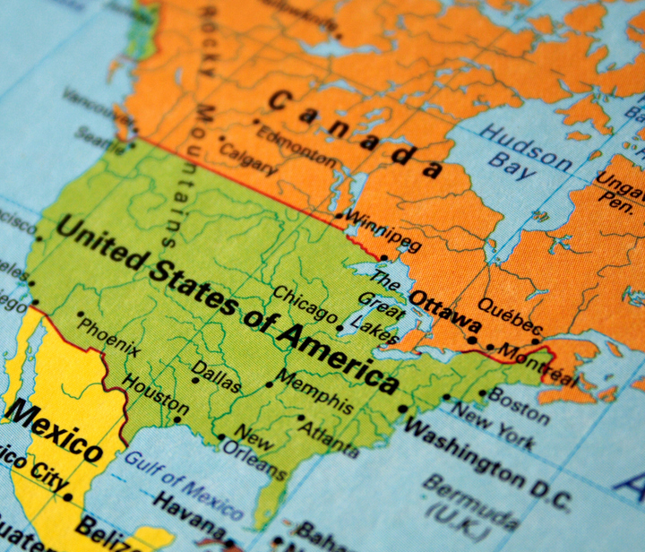
© NANOS RESEARCH
10
Q - To what extent do you support or oppose Prime Minister Mark Carney negotiating a renewed trade agreement with [ROTATE] the United States and Mexico?
Support for Prime Minister Carney to negotiate a trade deal with Mexico and the US
86 percent of Canadians
support or somewhat Prime Minister Carney negotiating a trade deal with the US and Mexico. Nine out of ten Canadians older than 55 support or somewhat support negotiating a renewed trade deal with Mexico and the US while just under eight out of ten Canadians between the ages of 18 and 34 support or somewhat support negotiating a trade deal.
*Weighted to the true population proportion.
*Charts may not add up to 100 due to rounding.
Source: Nanos Research, RDD dual frame hybrid telephone and online random survey, February 8th to 16th, 2026 n=1007, accurate 3.1 percentage points plus or minus, 19 times out of 20.

Slide 11
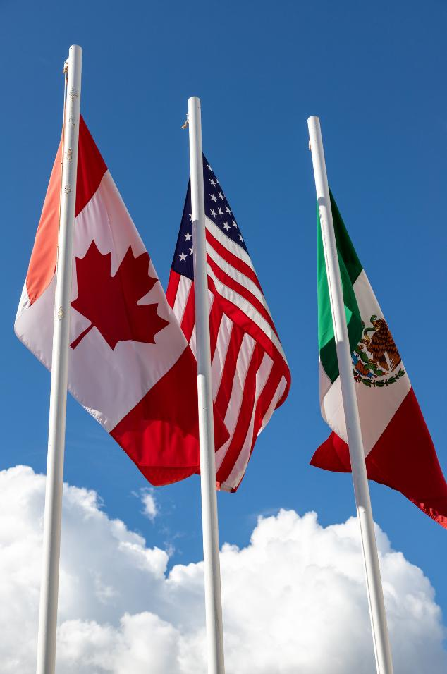
© NANOS RESEARCH
11
Q - Despite ongoing trade disputes with the United States, going forward, how important or unimportant is preserving Canada’s trade agreement with [ROTATE] the United States and Mexico to the following: [ROTATE]
Importance of preserving Canada’s trade deal with Mexico and the US
Majority of Canadians
believe that despite the current trade disputes with the US the preservation of Canada’s trade agreement with the United States and Mexico is important to some extent to the overall financial wellbeing of Canadians and to the Canadian economy. Men are more likely to deem preserving Canada’s trade agreement as important (55% overall financial wellbeing, 53% Canadian economy) than women (45% overall financial wellbeing, 44% Canadian economy).
*Weighted to the true population proportion.
*Charts may not add up to 100 due to rounding.
Source: Nanos Research, RDD dual frame hybrid telephone and online random survey, February 8th to 16th, 2026 n=1007, accurate 3.1 percentage points plus or minus, 19 times out of 20.

Slide 12

Political and economic mood.

Slide 13
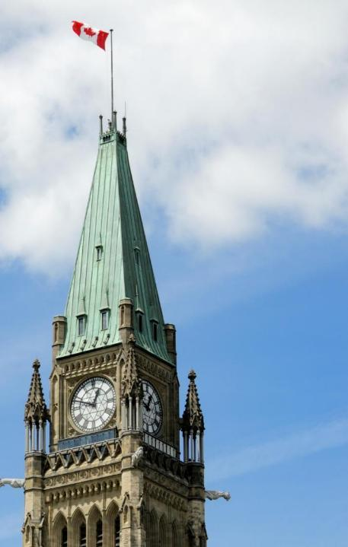
© NANOS RESEARCH
Performance of the federal government – Tracking
Q - Would you describe the performance of the current Federal Liberal Government led by Prime Minister Mark Carney as very good, somewhat good, average, somewhat poor or very poor? (2007-2025 waves)
*Note: Stephen Harper was Prime Minister for the 2007-2014 waves, Justin Trudeau was Prime Minister for the 2015-2024 waves, Mark Carney became Prime Minister starting in the 2025 wave.
*Weighted to the true population proportion.
*Charts may not add up to 100 due to rounding.
Source: Nanos Research, RDD dual frame hybrid telephone and online random survey, December 27th to December 29th, 2025, n=1,077, accurate 3.0 percentage points plus or minus, 19 times out of 20.

Slide 14
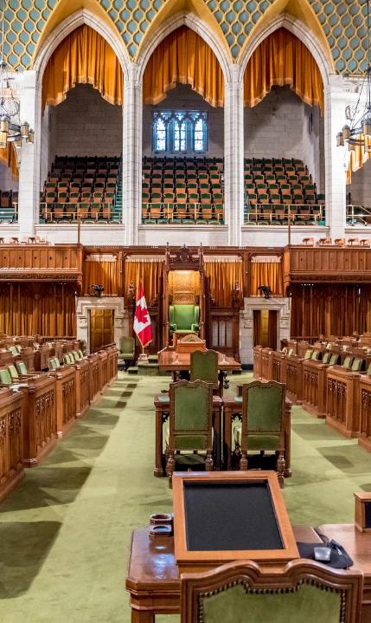
© NANOS RESEARCH
Q - Would you say that Canada as a country is moving in the right direction or the wrong direction?
*Weighted to the true population proportion.
*Charts may not add up to 100 due to rounding.
Source: Nanos Research, RDD dual frame hybrid telephone and online random survey, December 27th to December 29th, 2025, n=1,077, accurate 3.0 percentage points plus or minus, 19 times out of 20.

Slide 15
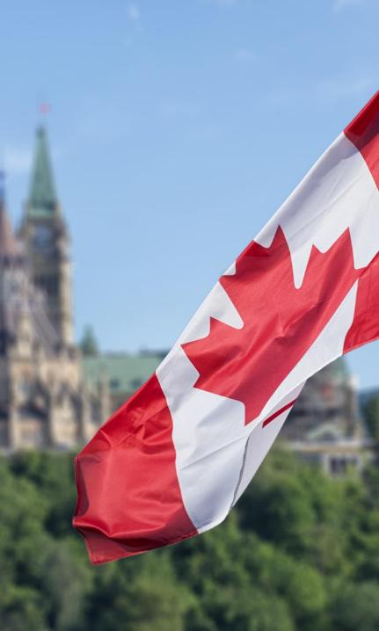
© NANOS RESEARCH
Change in the international reputation of Canada – Tracking
15
Q – On a scale of 1 to 5, where 1 is not improved and 5 is improved, how would you rate Canada’s reputation around the world over the past year?
*Weighted to the true population proportion.
*Charts may not add up to 100 due to rounding.
Source: Nanos Research, RDD dual frame hybrid telephone and online random survey, December 27th to December 29th, 2025, n=1,077, accurate 3.0 percentage points plus or minus, 19 times out of 20.

Slide 16
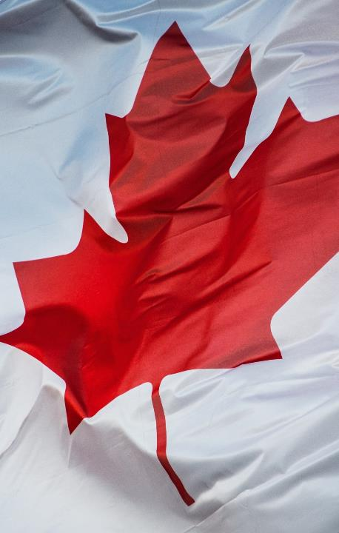
© NANOS RESEARCH
WEEKLY TOP TEN ISSUES – FOUR WEEK CHANGE
Question: What is your most important NATIONAL issue of concern? [UNPROMPTED]
*Weighted to the true population proportion.
*Charts may not add up to 100 due to rounding.
Source: Nanos Research, RDD dual frame (land- and cell-lines) telephone survey, weekly tracking ending April 10, 2026, n=1,027, accurate 3.1 percentage points plus or minus, 19 times out of 20.
NANOS

Slide 17
Ballot – LONG TERM
National – Weekly Tracking
(Ending April 10, 2026, n=858)
Question: For those parties you would consider voting for federally, could you please rank your top two current local preferences? [Unprompted] [1ST CHOICE, 2ND CHOICE RANK]
NANOS

Slide 18
PREFERRED PM – LONG TERM
National – Weekly Tracking – Preferred Prime Minister First Ranked Choice
(Ending April 10, 2026, n=1,027)
Question: Of the current federal political party leaders, could you please rank your top two current local preferences for Prime Minister? [ROTATE PARTY LEADERS]
NANOS

Slide 19
© NANOS RESEARCH
ONE YEAR TREND LINE
Bloomberg Nanos Canadian Confidence Index
(Weekly Completed April 10, 2026)
The BNCCI is a diffusion index comprised of the views of 1,000 Canadians. A score of 50 on the diffusion index indicates that positive and negative views are a wash while scores above or below 50 suggest net positive or net negative views in terms of the economic mood of Canadians. The data is based on perceptions related to personal finances, job security, economic strength, and real estate value.
Source: Nanos Research, random telephone survey (land- and cell-lines) with 1,027 Canadian consumers aged 18 years and over, ending April 10, 2026. The data is based on a four-week rolling average where each week the oldest group of 250 interviews is dropped and a new group of 250 is added. A random survey of 1,027 Canadian consumers is accurate 3.1 percentage points, plus or minus, 19 times out of 20.

Slide 20
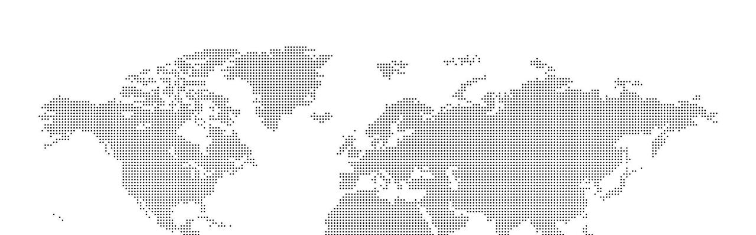

Foreign Affairs Monitor
Second Edition 2025
The Foreign Affairs Monitor by Nanos Research offers a comprehensive analysis of Canadian and American perspectives on key national and international issues. This essential resource provides policymakers with actionable insights into public sentiment of seven countries grouped into three regions: Asia, Europe, and North America.
Every year the analysis in this syndicated report for paid subscribers is expanded and updated by the Nanos team in the Q3 each year.
It is a deep dive that is a go-to resource for anyone wanting to understand how to navigate public opinion. With 20-year Canadian and US public opinion trendlines on key topics, it is a unique source of understanding the foreign affairs mood.
Notes:
2020-1705

Slide 21
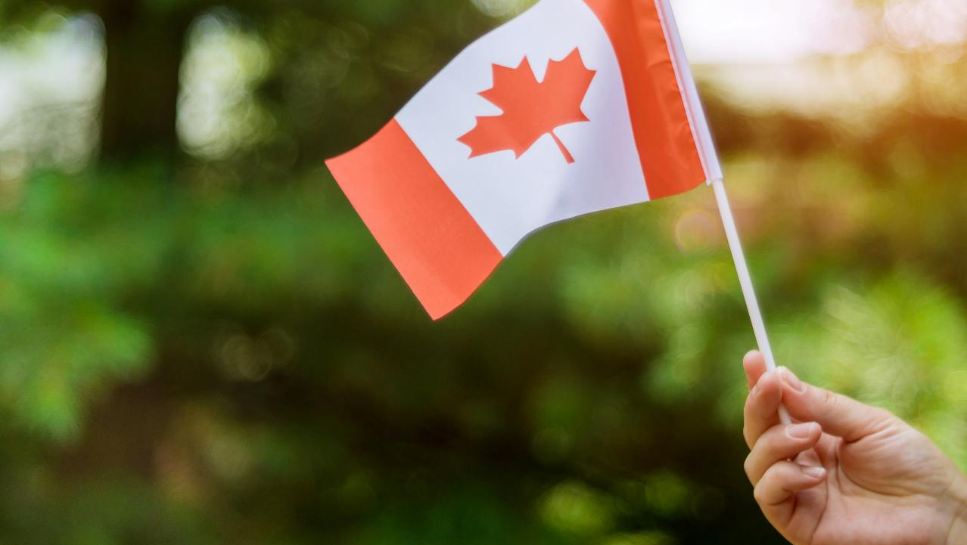
CANADA:
THE PRAGMATIC PIVOT
21
“The relationship with the United States is increasingly complicated. The familiar warmth of cross-border ties has cooled from a Canadian perspective, replaced by a kind of wary calculation.”

Slide 22
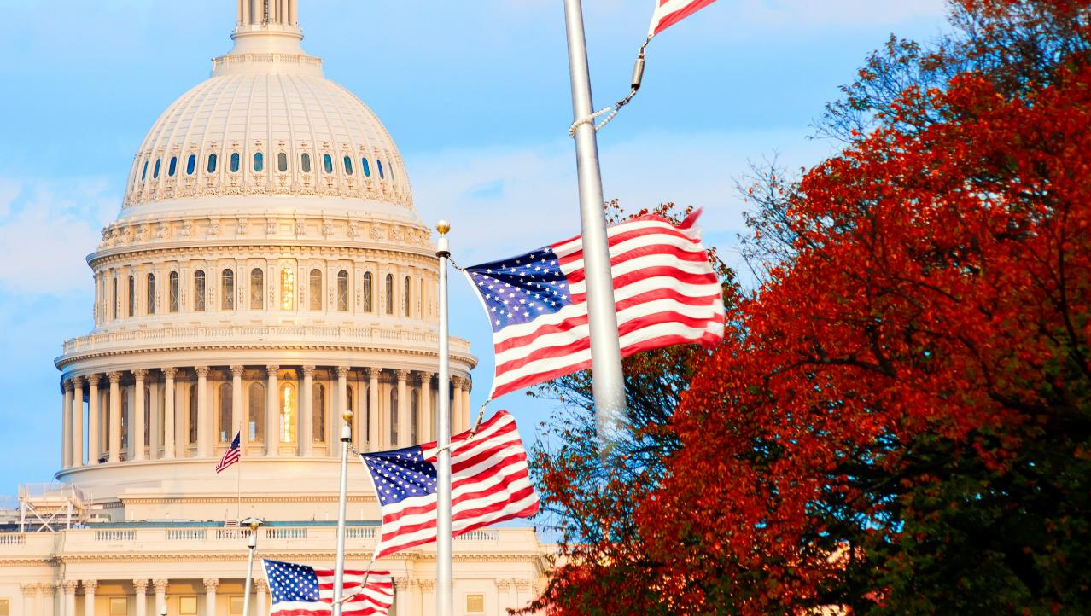
UNITED STATES:
WHERE US DOMESTIC POLITICS COLLIDES WITH TRADITIONAL ALLIES
22
“American are no longer immune to the pressures of US domestic politics and shifting global dynamics.”

Slide 23

MEXICO:
STEADY IMPROVEMENT IN SENTIMENT AS PEOPLE FOCUS ON CHINA
23
“Negative perceptions of Mexico have been on the decline as both Americans and Canadians increasingly focus on China and the border.”

Slide 24

UNITED KINGDOM:
OLD ALLIES, NEW TENSIONS
24
“The public opinion suggests that as positive views of the US in Canada decline, the UK is one of the key beneficiaries in positive perceptions, especially as they relate to common values.”

Slide 25

GERMANY:
INCREASINGLY ON THE RADAR FOR CANADIANS
25
“As the views Canadians have of the US become more mixed, Germany increasingly is on the radar.”

Slide 26
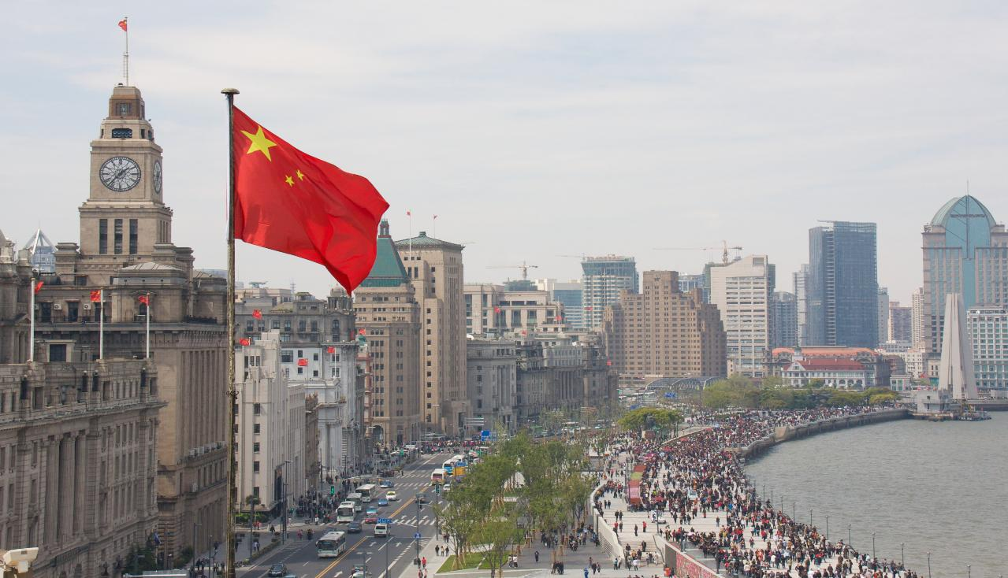
CHINA:
THE US COUNTERBALANCING
RIVAL
26
“The Canadian and American publics view China as both an indispensable economic partner and a strategic competitor.”

Slide 27
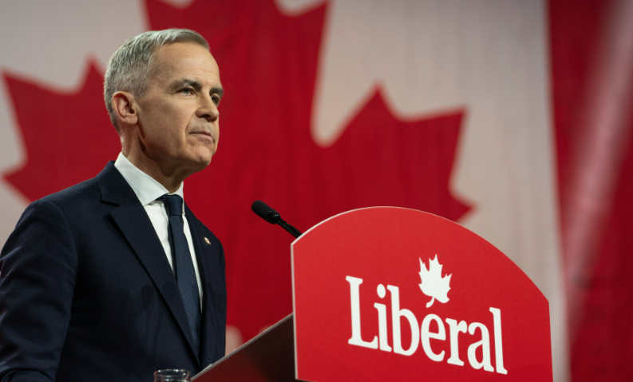
The Davos Rupture

